Slide 1

Review: Probability Theory (2)
Chris Kiekintveld

Slide 2
What are probabilities?
Probabilities describe the likelihood of different types of events events
The probability of rolling a 6 on a fair die is 1/6
The probability of rain tomorrow may be 20%
Ratio: (Observed events)/(Number of Events)
Objective/frequentist
Probabilities describe empirical frequencies
Subjective/Bayesian
Probabilities describe subjective beliefs

Slide 3
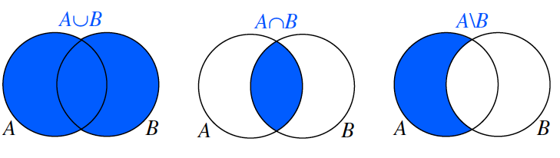
Set Theory
Sets are collections of objects (events)
Basic operations:
Union, Intersection, Difference
Measure theory is used for uncountably infinite sets; we will work mostly with finite sets

Slide 4
Sample Space
Most fundamental description of the domain
Experiments or observations
Results in an outcome (sample)
Outcomes are complete and disjoint
Samples space is the set of possible outcomes
Toss a coin twice
S = {HH, HT, TH, TT}

Slide 5
Probability definition
Event: a subset of possible outcomes
A={HH}, B={HT, TH}
Atomic events: (mostly) interchangeable with outcome
Probability of an event : an number assigned to an event Pr(A)
Axiom 1: Pr(A) ≥ 0
Axiom 2: Pr(S) = 1
Axiom 3: For every set of disjoint (independent) events:

Slide 6
Some Consequences

Slide 7
Joint Probability
For events A and B, joint probability Pr(A,B) stands for the probability that both events happen
Example: A={HH}, B={HT, TH}, what is the joint probability Pr(AB)?

Slide 8
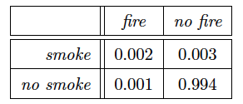
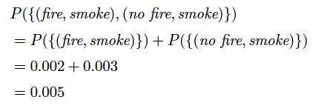
Joint Probability Tables
Given random variables defined on a valid probability space (complete and disjoint outcomes), we can write joint distributions
Non-negative, sum to 1
Joint probabilities on atomic events capture the full detail of the domain
Can be used for inference of other probabilities

Slide 9
Marginal Probabilities
Eliminate some variables from the distribution, keeping a subset
Sum over the eliminated variables
0.005
0.995
0.003
0.997

